Slide 1
Linux Kernel Module
Rohit Pujari 75 and Vivek Pundkar 77

Slide 2
CONTENT
What is Linux Kernel Module
Hello Word program in LKM
LKM command
How do I run a kernel module

Slide 3
What is Linux Kernel Module
A Kernel Module is a small file that may be loaded into the running Kernel, and unloaded, at will (the next generation of the Linux kernel will not allow unloading modules, unless told otherwise).
Many functions of the Kernel may either be compiled into the Kernel directly, or compiled as Modules.
This design makes it faster to load the Kernel (no need to load and initialize un-needed Modules), as well as developing Drivers (if you have a bug, just unload the Module, fix it, recompile and load it again).

Slide 4
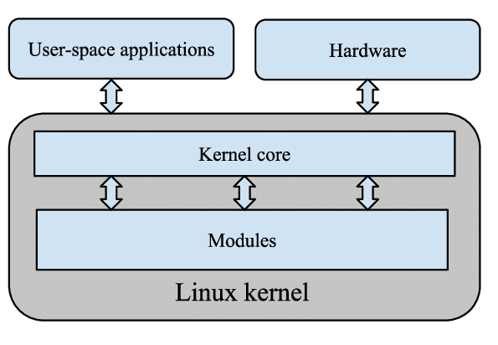

Slide 5
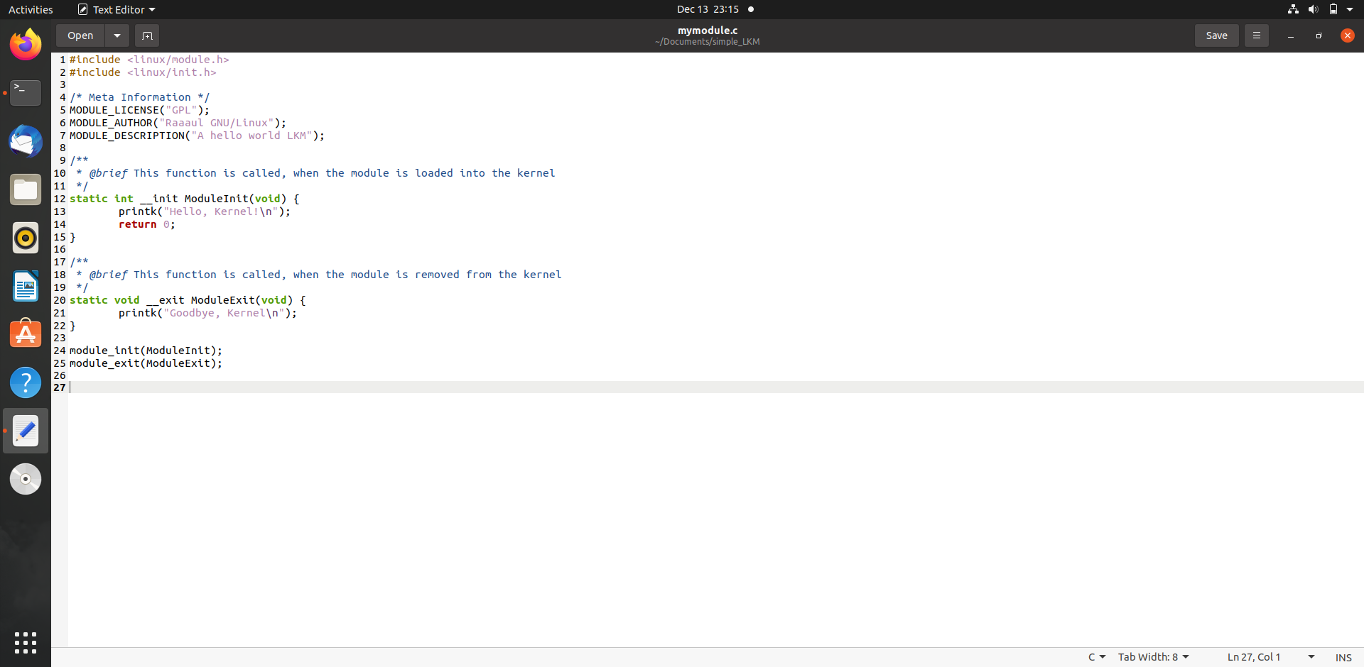
Hello Word program in LKM

Slide 6
LKM commands
You can use the command uname -r to get your current kernel release version.
To show what kernel modules are currently loaded:
$ lsmod
To show information about a module:
$ modinfo module_name
To list the options that are set for a loaded module:
$ systool -v -m module_name
To display the comprehensive configuration of all the modules:
$ modprobe -c | less
To display the configuration of a particular module:
$ modprobe -c | grep module_name
List the dependencies of a module (or alias), including the module itself:
$ modprobe --show-depends module_name

Slide 7
Manual module handling
Kernel modules are handled by tools provided by kmod package. You can use these tools manually.
To load a module:
modprobe module_name
To load a module by filename (i.e. one that is not installed in /usr/lib/modules/$(uname -r)/):
insmod filename [args]
To unload a module:
modprobe -r module_name
Or, alternatively to unload a module :
rmmod module_name

Slide 8
Results
The system must be prepared to build kernel code, and to do this you must have the Linux headers installed on your device.
On a typical Linux desktop machine you can use your package manager to locate the correct package to install.

Slide 9
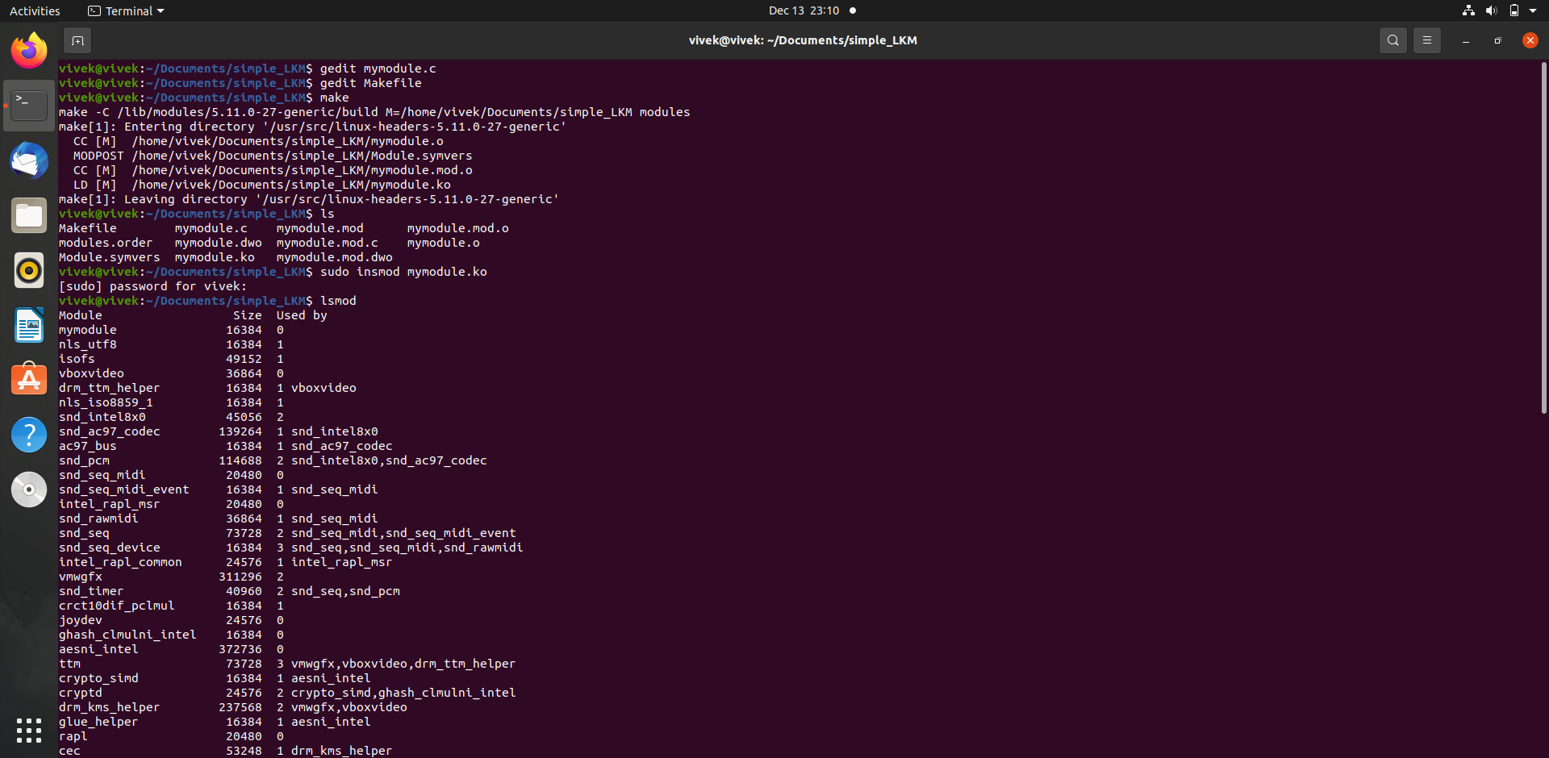

Slide 10
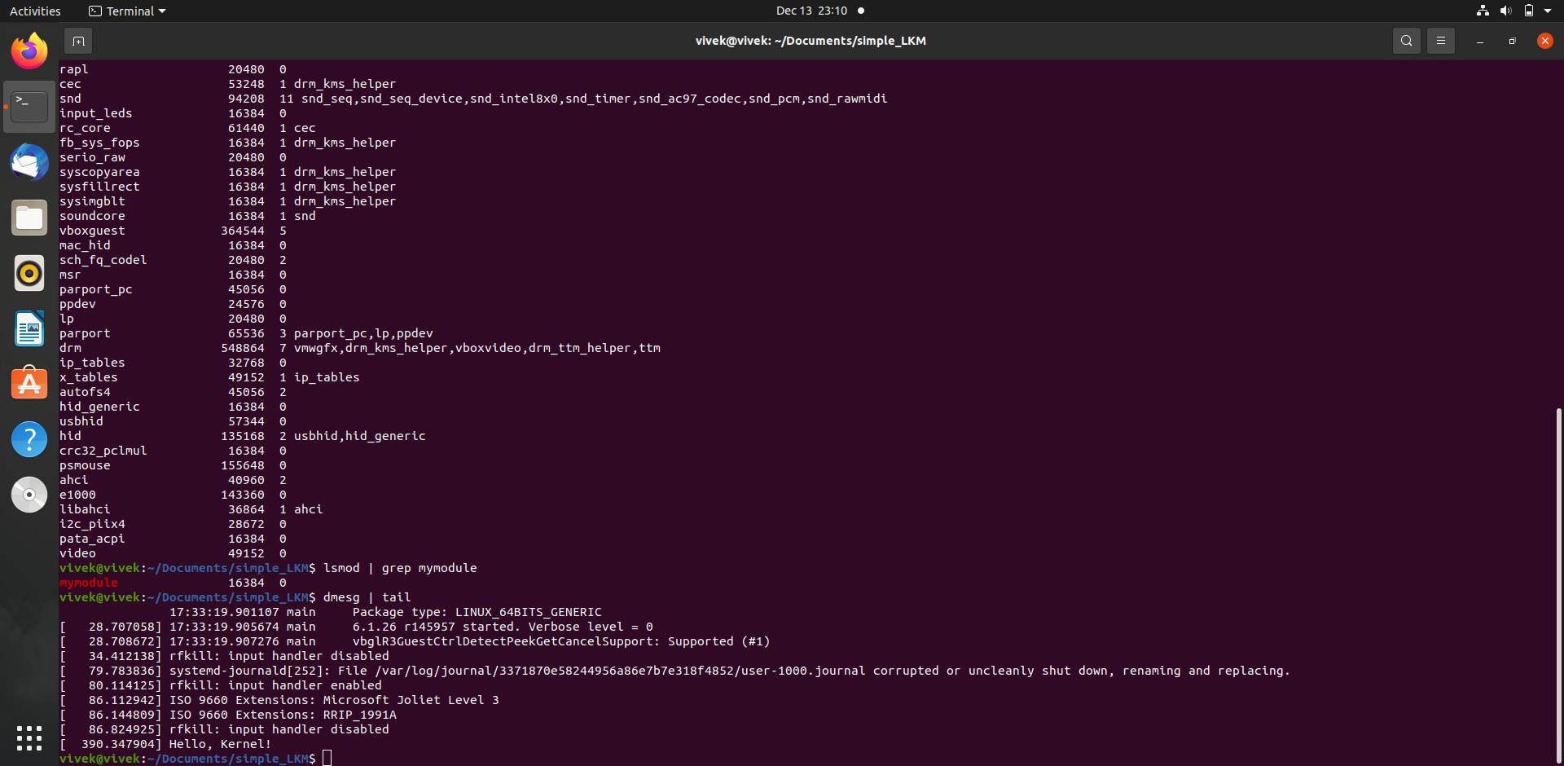

Slide 11
